Slide 1
Multithreading And Parallel Programming

Slide 2
Background - The world of multi-threading on modern hardware
Background - The world of multi-threading on modern hardware
Single core
Thread Context Switching
Multiple Core
Note: Always remember having multiple CPUs and multiple Cores (Processors) are different things. In case of multiple CPU you will have more than one physical CPU attached to your motherboard (not common in home PCs or desktop computers). In case of multiple core you will have SINGLE CPU attached to your motherboard but because of multiple cores your CPU can actually perform more than one instruction in parallel.

Slide 3
Multi-threaded programs - What does it really mean
Multi-threaded programs - What does it really mean
Threads are the smallest unit of execution scheduled by the operating system.
Any program or application has a minimum of one thread be it your ASP.net application or a console window application.
If you want to do work more fast you will have to employ multiple threads running in parallel.
To view count of Cores on your computer, open Windows Task Manager -> count each graph under the "CPU Usage History" section.

Slide 4
Types of Threads
Foreground Thread:
By default the Threads are created as Foreground Thread using ‘Thread’ class.
FT keeps running even if the Main App quits, until they finish their execution.
Background Thread:
BT will quit if Main App quits.
Set ‘IsBackground’ property of Thread to true to make it BT.

Slide 5
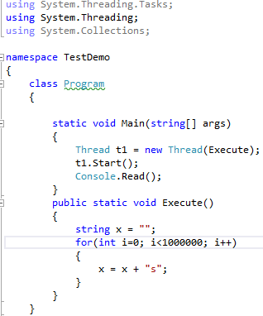
Threading Program

Slide 6
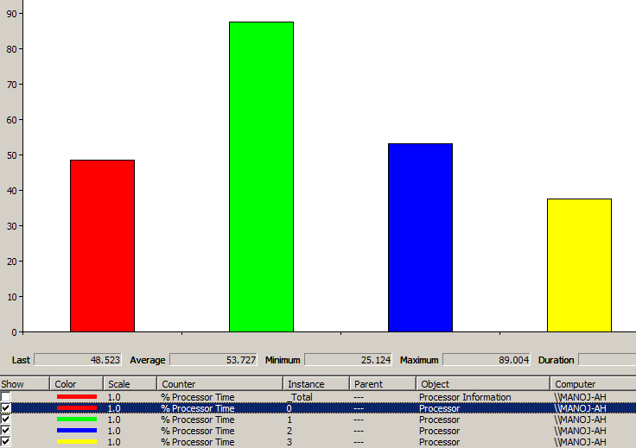
Perfmon graph – For Threading

Slide 7
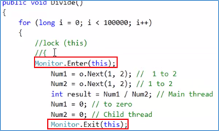
Thread Synchronization
When two or more threads need to access a shared resource at the same time, the system needs a synchronization mechanism to ensure that only one thread at a time uses the resource.
In .Net, there are 3 Thread Synchronization ways to achieve Thread Safety:
- Lock (shortcut syntax for Monitor)
- Mutex
- Semaphore
Use these mechanisms on code (Critical Section) that should be executed only by 1 thread at a time. In this way we can make the objects Thread Safe.

Slide 8
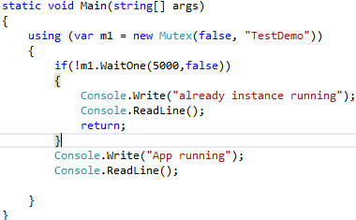
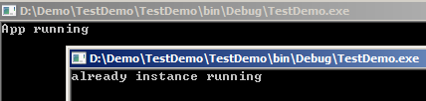
Mutex
Lock (Monitor): Ensure Thread safety for in-process Threads (Internal) ie. Threads generated by the App. No support for out-process threads.
Mutex: Ensure Thread safety for out-process Threads (External) ie. Threads coming from external App to our App. Use Mutex when we want that our App should be accessed by only 1 External Thread.
Eg: Open any console app exe, we can double click and execute the exe multiple times, multiple new console window opens. In such case use Mutex to allow only 1 external Thread to access the App exe.

Slide 9
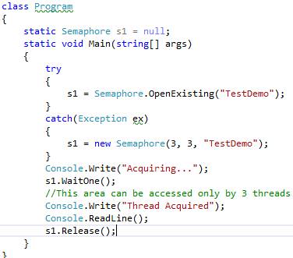
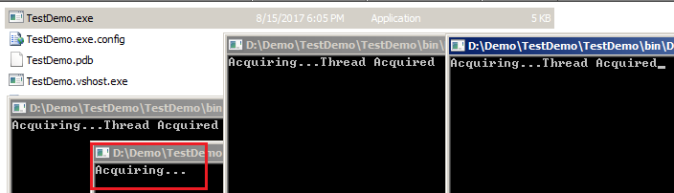
Semaphore and Semaphore Slim
Lock and Mutex allow only 1 Thread to enter in Critical Section.
Semaphore and Semaphore Slim allow one or more Threads to enter in Critical Section.
Semaphore is advanced version of Mutex (Thread Safety for External Threads)
Semaphore Slim is advanced version of Lock (Thread Safety for Internal Threads)
Eg: As the max capacity is set to 3, only 3 external threads can acquire Semaphore.

Slide 10
Thread Pooling
When a client request comes in, a thread is created to serve the request. Resources are allocated by OS to the Thread, like Memory, etc. Then Task is executed and GC runs to deallocate the Thread Object.
But after ‘Task Execution’, instead of running GC to free thread Object, if we put the Thread in Thread Pool, then we don’t have to repeat the 3 steps for every new request (Thread Object creation, Resource Allocation by OS and GC).
Advantage of Thread Pool
-Thread object creation and resource allocation is done only once.
-We can put limit to no. of Threads in Thread Pool.
ThreadPool can be implemented in 2 ways:
- Using TPL
- Use ThreadPool class instead of Thread class to create thread object.

Slide 11
Performance
Always remember thread synchronization also comes with a performance cost as now all threads can't just go and update the global variable blindly. Thread synchronization constructs make sure that the update happens only by one thread at a time. If two threads arrive at the same time then one of them will have to wait so that he sees the latest value updated by other thread before updating.
There is every possibility of this solution to be even more worse performing than the previous two as most of the job is CPU-bound which results in context switching of all 10 threads and you are using multi-threading with thread synchronization. So you pay the cost of all three - Creation and management of threads, CPU context switching and Thread Synchronization.

Slide 12
Parallel Programming - TPL (Task Parallel Library)
A Task is a reference type found in System.Threading.Tasks namespace inside mscorlib.dll which is implicitly referenced in any C# project.
TPL optimally utilizes all the Cores equally, ie. load is balanced equally on all the Cores while execution.
Task defines What you want to run, Thread defines How the task should run.
Advantage of TPL (Task) over Threading:
-TPL optimally utilizes all Processors of the CPU.
-TPL encapsulates multi-Core execution.
-TPL uses Thread Pooling.
TPL uses ThreadPool, so there is no new object creation and releasing of object by GC.

Slide 13
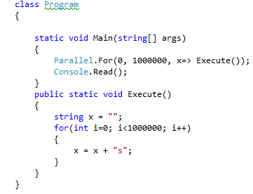
Parallel.For(): It is used to execute the method in parallel.

Slide 14
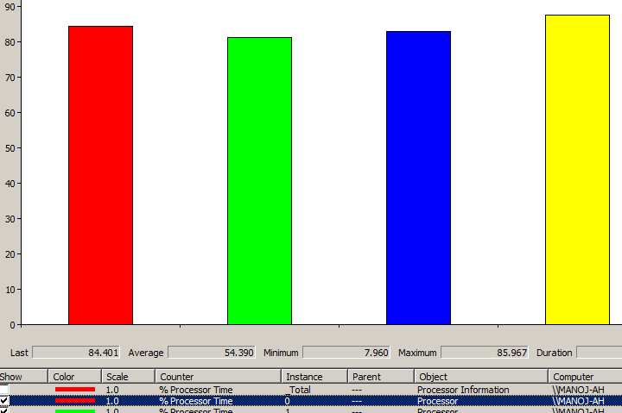
Perfmon graph – for Parallel programming

Slide 15
Thread Vs. Process
Process:
An executing instance of a program is called a process.
Some operating systems use the term ‘task’ to refer to a program that is being executed.
A process is always stored in the main memory also termed as the primary memory or random access memory.
A process can contain multiple Threads.
Example: Executing multiple instances of the ‘Calculator’ program. Each of the instance is termed as a process.
Thread:
A thread is a subset of the process.
It is termed as a ‘lightweight process’, since it is similar to a real process but executes within the context of a process and shares the same resources allotted to the process by the kernel.

Slide 16
Multithreading Vs. Parallel Programming
Both Multithreading and Parallel Programming are used for doing the multi task in concurrent way.
In Multithreading, Threads are executed in single core more , so load given to the core is not split based on balance. It is allocated based on the sequence , threads are allocated more to perform in single core. After the core is heavy loaded, remaining threads are then allocated to remaining core.
In Multithreading, If we want to allocate equal load to all Cores, it has to be handled by developers. It is more complex to find which core is heavy loaded , and on which core we have to execute the thread.
In Parallel Programming, we create the threads in parallel and execute equal number of threads in all Cores at the same time.
CPU load is balanced by allocating the threads equally in all cores.
Thus, equal thread allocation to all the Cores is handled internally by Parallel programming.
In Threading, we do Time Slicing ie. context switching and not actual parallel execution. Processor gives time to each Thread for execution and switches between these Threads.

Slide 17
When to use Threadpool is more appropriate?
If your background workloads are primarily and purely fire-and-forget asynchronous work, then using QueueUserWorkItem may be appropriate e.g. Processing the content of csv files getting continuously created in a directory and then dumping the read content into a database table.

Slide 18
When using TPL is more appropriate
Following scenarios might prompt you to use TPL:
If you want to use new features (continuation options, knowing the completion state of a thread, returning a value after work is done, etc) of TPL
If you want to keep your UI responsive all the time
If you have ever worked or want to work on windows store applications then TPL is the new gateway to leverage thread-pool. Although, ThreadPool class has also been reintroduced inWindows.System.Threading namespace to leverage its QueueUserWorkItem API as Windows Store Apps don't have access to System.Threading namespace anymore.
If you have any other multi-threading need which doesn't fit other two scenarios mentioned in this section i.e. creating the thread directly for full control or using conventional thread pool for fire and forget scenario.

Slide 19

Thank You!
Name: Manoj Ambhore
Designation: Senior Software Developer.
Manoj.ambhore@xoriant.com
www.xoriant.com
India
Mumbai
4th Floor, Nomura
Powai , Mumbai 400 076
Pune
5th Floor, Amar Paradigm
Baner, Pune 411 045
Kolkata
2B, 12th Floor, Tower ‘C’
Rajarhat, Kolkata 700 156
India
Mumbai
4th Floor, Nomura
Powai , Mumbai 400 076
Pune
5th Floor, Amar Paradigm
Baner, Pune 411 045
Kolkata
2B, 12th Floor, Tower ‘C’
Rajarhat, Kolkata 700 156
US – Corporate Headquarters
1248 Reamwood Avenue,
Sunnyvale, CA 94089
Phone: (408) 743 4400
343 Thornall St 720
Edison, NJ 08837
Phone: (732) 395 6900
US – Corporate Headquarters
1248 Reamwood Avenue,
Sunnyvale, CA 94089
Phone: (408) 743 4400
343 Thornall St 720
Edison, NJ 08837
Phone: (732) 395 6900
UK
20 Broadwick Street
Soho, London
W1F 8HT, UK
89 Worship Street
Shoreditch,
London EC2A 2BF, UK
Phone: (44) 2079 938 955
UK
20 Broadwick Street
Soho, London
W1F 8HT, UK
89 Worship Street
Shoreditch,
London EC2A 2BF, UK
Phone: (44) 2079 938 955
Bangalore
4th Floor, Kabra Excelsior,
80 Feet Main Road, Koramangala 1st Block,
Bengaluru (Bangalore) 560034
Gurgaon
A/373rd Floor, Sigma Center
Gurgaon, Haryana 122 011s
Bangalore
4th Floor, Kabra Excelsior,
80 Feet Main Road, Koramangala 1st Block,
Bengaluru (Bangalore) 560034
Gurgaon
A/373rd Floor, Sigma Center
Gurgaon, Haryana 122 011s

